Slide 1

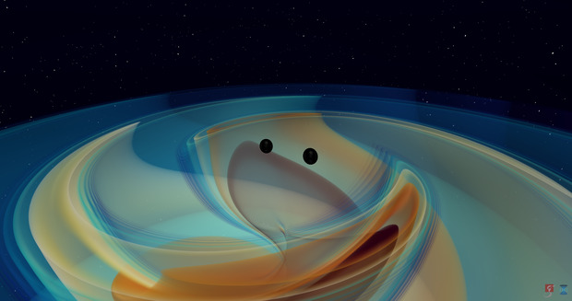
Exploring the Scope of Multiband Detection with
Next-Generation Gravitational Wave Detectors
Akshita Mittal, IMS19027
Data Science Minor Project 2023
Supervisors: Dr Apratim Ganguly, Dr Shabnam Iyyani

Slide 2
Introduction

Slide 3
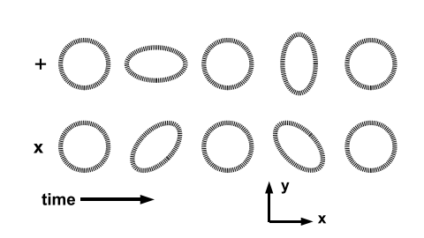
Understanding Gravitational Waves
Ripples in space-time caused by accelerating massive objects
Have two polarizations--- "plus" and "cross"
Primary sources:
Binary systems
Supernovae
Continuous gravitational waves
Stochastic gravitational wave background
Fig. 1.1: Effect of a passing gravitational wave on test particles.

Slide 4
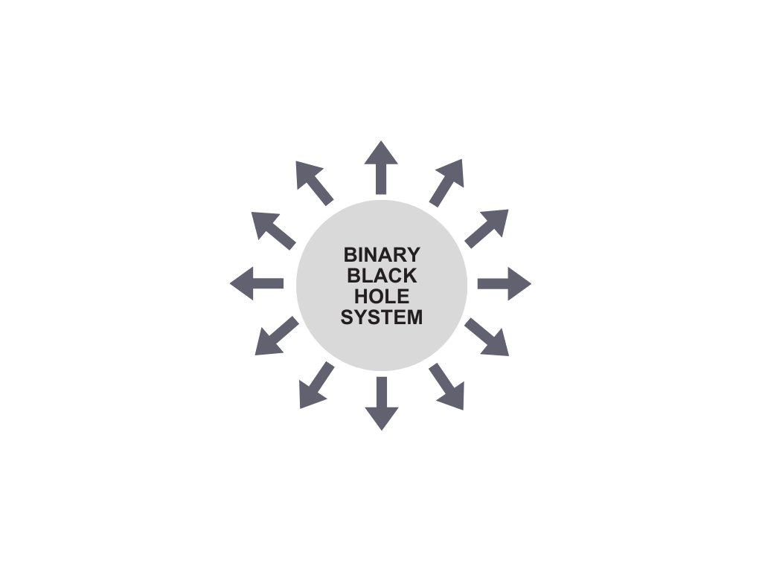

Source Parameters
Primary Mass (m₁)
Luminosity Distance (D_{L})
Secondary Mass (m₂)
q = m₂/m₁
Phase (Φ_{c})
Mass Ratio (q)
𝓜 = (m₁m₂)^{3/5}/(m₁+m₂)^{1/5}
Right Ascension (⍺)
Chirp Mass (𝓜)
Declination (δ)
Spin Amplitude 1 (a₁)
Spin Vector Azimuthal Angle (Φ₁₂)
Spin Amplitude 2 (a₂)
Precession Angle (Φ_{jl})
Fig. 1.2: Illustration of source parameters and definitions

Slide 5
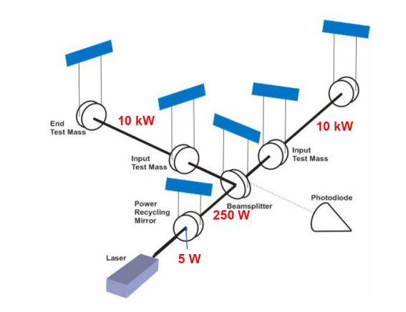
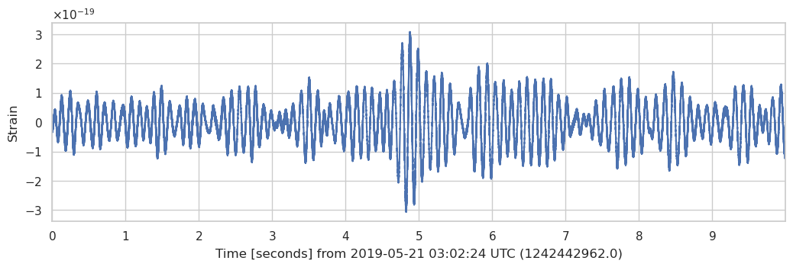
Detecting Gravitational Waves
Fig. 1.3: Simple design of a LIGO interferometer.
Fig. 1.4: Time series data for LIGO Hanford around GW190521

Slide 6
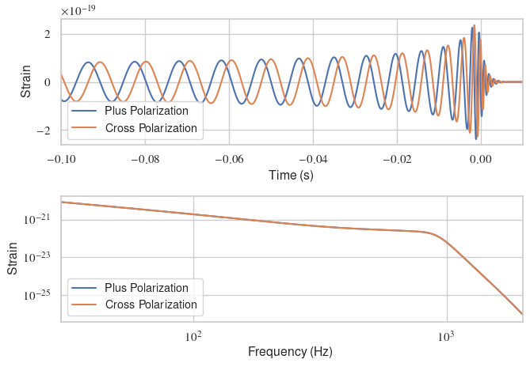
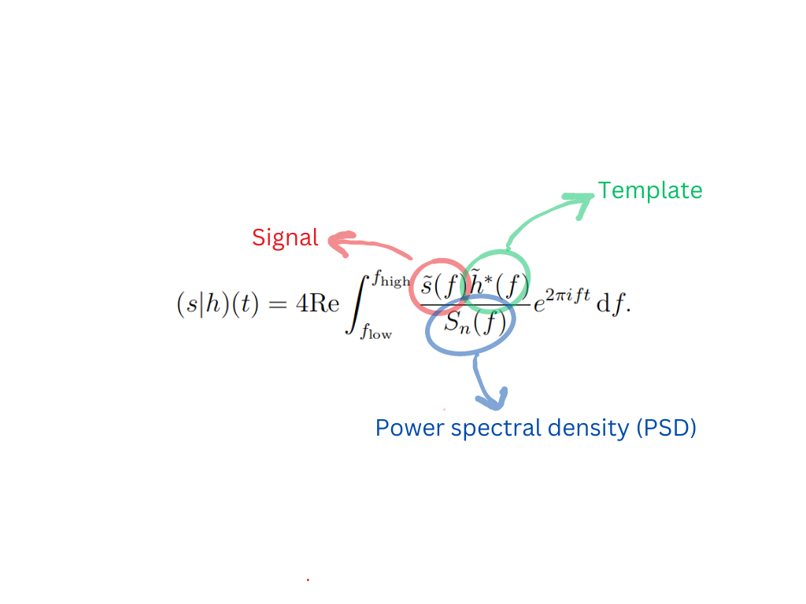
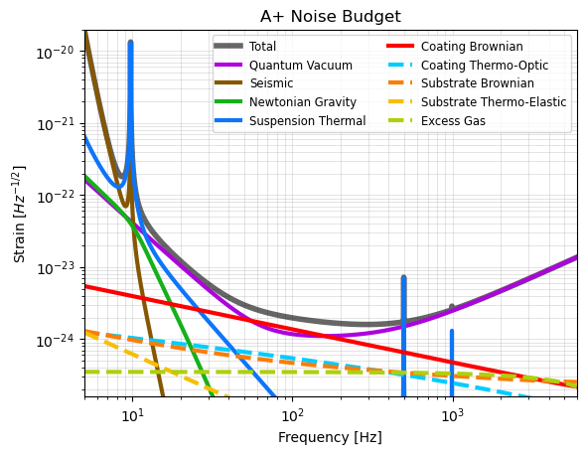
Post-Merger Data Analysis
Fig. 1.4: Time series data for LIGO Hanford around GW190521
Fig. 1.5: Time and frequency domain signals for IMRPhenomD
(1.1)
Matched filtering is our end goal!
Fig. 1.6: Noise budget evaluated using GWINC

Slide 7
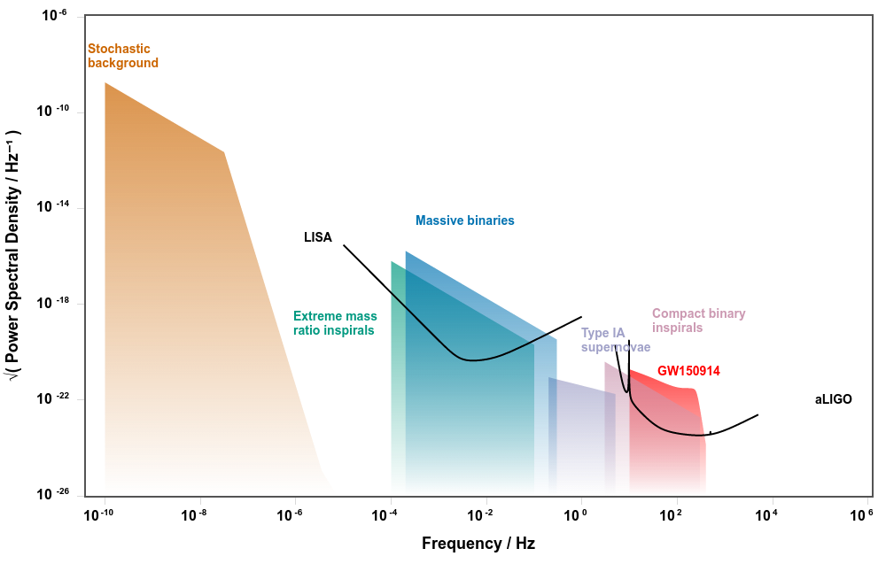
Present Status
Fig. 1.7: To illustrate the frequency bands of active and future detectors. Made using GWPlotter
Notes:
- LIGO has only detected stellar mass black holes
- Intermediate mass BHs have remained elusive

Slide 8

Objective
To understand the detection capability of a proposed deci-hertz detector
Multiband detection of heavier-mass black holes
Fig. 1.8: To illustrate the placement of a deci-hertz detector

Slide 9
2. Framework
Notes:
Before we proceed with the presentation, I'd like to briefly introduce some key concepts that will be referenced later.

Slide 10
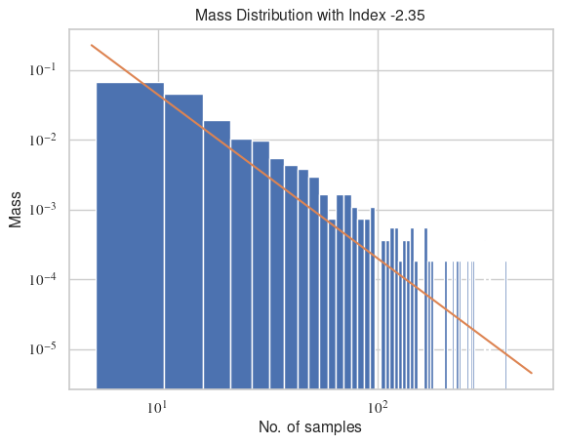
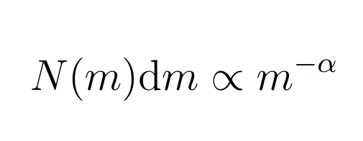
Salpeter Mass Distribution
Power law function with index (𝛼) = -2.35
Gives relation between number of stars with mass m in mass range dm
(2.1)
Fig. 2.1: Salpeter mass distribution. Plotted in log scale.
Notes:
The Salpeter mass function is a statistical distribution that describes the distribution of masses for a population of stars. The Salpeter mass function is characterized by a high number of low-mass stars and a small number of high-mass stars. The Salpeter mass function can also be used to describe the distribution of masses for black holes, which are compact objects formed by the gravitational collapse of massive stars. This is because the process of black hole formation is closely tied to the initial mass of the progenitor star, which determines the mass of the black hole that is formed. In fact, recent observations of merging black holes and neutron stars by LIGO and Virgo have confirmed the presence of a population of compact objects with masses that are consistent with a Salpeter-like distribution.

Slide 11
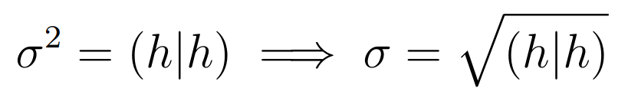
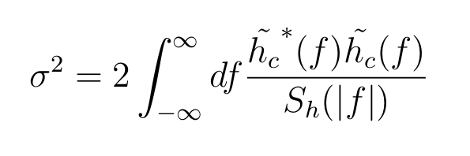
Optimal SNR (σ)
σ² is defined as the inner product of a signal with itself
Quantifies loudness of the noise of a detector
We use it to quantify the loudness of the signal
For a signal h,
(2.2)
(2.3)
Notes:
σ^2 is used to characterize the noise in the LIGO detectors and to estimate the sensitivity of the detectors to gravitational waves. The lower the value of σ^2, the less noisy the detector is. In this study, we will be conducting zero noise injections, so sigma will help us quantify how loud our signal is

Slide 12
3. Methodology

Slide 13
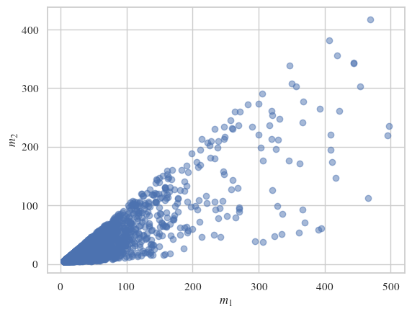
Generating a BBH Population
Population size = 1000
Salpeter mass distribution for primary mass
Uniform priors placed on other parameters
Fig. 3.1: Mass distribution for generated BBH population.
Notes:
The power law distribution is motivated by astrophysical models of black hole formation, which suggest that black holes are formed from the collapse of massive stars. In this scenario, the mass of a black hole is determined by the mass of the progenitor star, and the distribution of progenitor star masses is believed to follow a power law distribution. This leads to a corresponding power law distribution for the masses of the black holes that are produced.
In some cases, it may be appropriate to use a uniform prior distribution for a parameter. A uniform prior assigns equal probability to all possible values of the parameter within a specified range. This means that the prior distribution does not favor any particular value of the parameter, and it can be interpreted as expressing a lack of prior knowledge or bias about the parameter.
Uniform priors are often used for parameters that are not expected to have any particular value or range of values based on prior knowledge or physical considerations. For example, in gravitational wave data analysis, uniform priors may be used for parameters such as the distance to the binary black hole merger or the orientation of the binary system with respect to the detector. In these cases, there may be no reason to favor any particular value or range of values for these parameters, and a uniform prior can provide a simple and non-informative prior distribution.

Slide 14
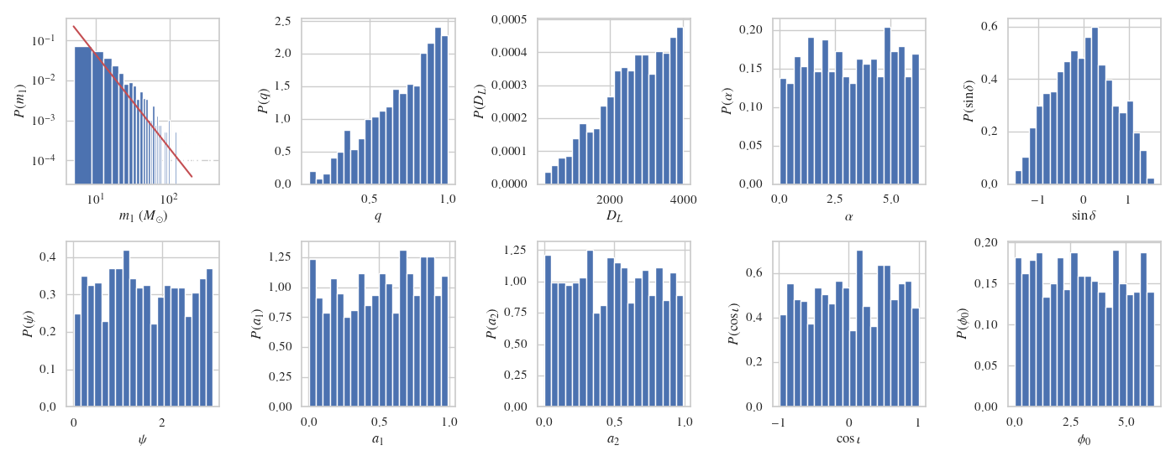
Generating a BBH Population
Fig. 3.2: Distribution of parameters for generated population

Slide 15
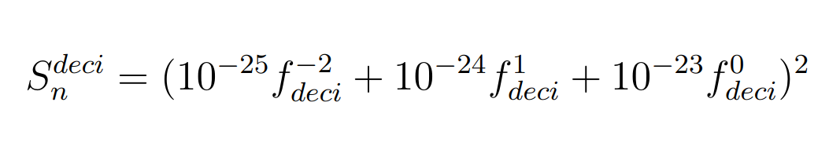
Generating PSDs
PSDs of HLV obtained from LIGO DCC
PSD for the proposed deci-hertz observatory empirically determined
Sampling rate chosen to be 4096Hz
Lower bounds on HLV at 10Hz, deci-hertz at 0.05Hz
(3.1)
Notes:
The PSDs of HLV taken for our analysis are from the A+ sensitivity and have been taken from the LIGO document control center.

Slide 16
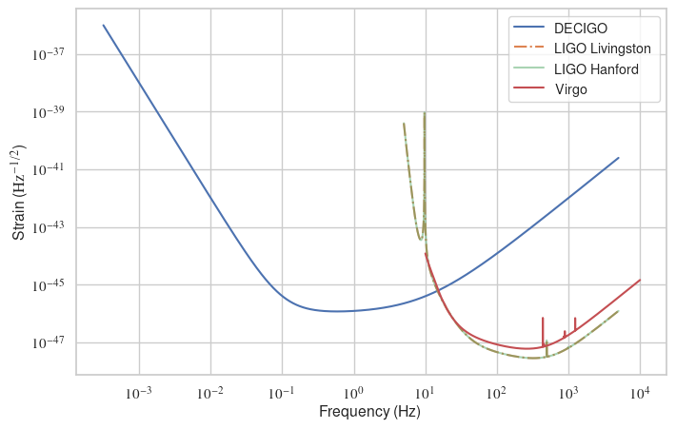
Generating PSDs
Fig. 3.3: Theoretical PSDs for proposed deci-hertz observatory and HLV

Slide 17
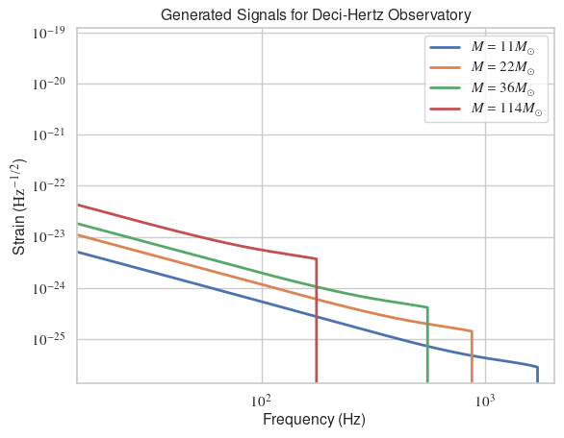
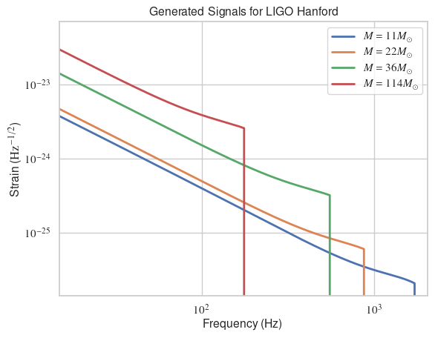
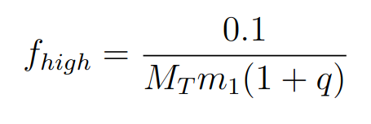
Generating Signals
IMRPhenomD used to create frequency domain signals for 1000 systems
Antenna pattern functions for HLV and deci-hertz observatory taken into account
High frequency cutoff placed at 𝑓_{high}, where
Fig. 3.4 (a): Sample of generated signals for deci-hertz
(3.2)
M_{T} = Solar mass in seconds, m₁= Primary mass, q = Mass ratio
Fig. 3.4 (b): Sample of generated signals for H1
Notes:
the antenna pattern refers to the directional sensitivity of the detector to gravitational wave signals. The antenna pattern depends on the geometry and orientation of the detector, as well as the polarization of the incoming gravitational wave. The antenna pattern for LIGO is complex and varies with the direction and polarization of the gravitational wave. In general, the LIGO detectors are most sensitive to gravitational waves that are coming from roughly overhead or directly beneath the detector, and are less sensitive to waves coming from other directions. This is because the interferometer arms are most sensitive to changes in distance along the direction of the arms, and are less sensitive to changes in distance perpendicular to the arms.

Slide 18
Calculation of σ
 | LIGO Hanford | Deci-hertz
σ | 14 | 200
Evaluation of σ for 1000 samples
Signal classified as detectable for σ>8
Example events:
Stellar-mass binary merger (A)
m₁=15M☉, m₂=12M☉, D_{L}=3000MPc
Intermediate mass binary merger (B)
m₁=150M☉, m₂=120M☉, D_{L}=2500MPc
Table 3.1: σ of stellar-mass binary merger.
 | LIGO Hanford | Deci-hertz
σ | 84 | 1436
Table 3.2: σ of intermediate-mass binary merger.

Slide 19
4. Results

Slide 20
Detectable Events
σ >8 events | LIGO Hanford | Deci-hertz
Out of 1000 events | 607 | 1000
Table 4.1: Number of events with σ>8 out of 1000.
Notes:
Normal distribution of SNRs obtained
Skewed towards higher values of SNR

Slide 21
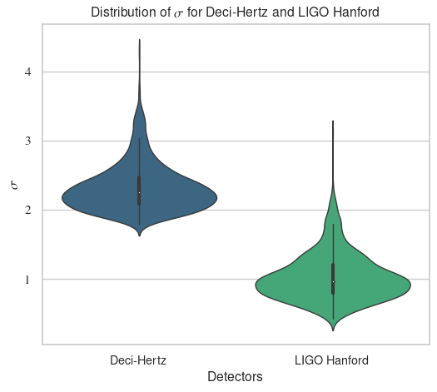
Distribution of SNR (σ)
Fig. 4.1: Distribution of σ for decihertz and LIGO Hanford (H1).
Notes:
Normal distribution of SNRs obtained
Skewed towards higher values of SNR

Slide 22
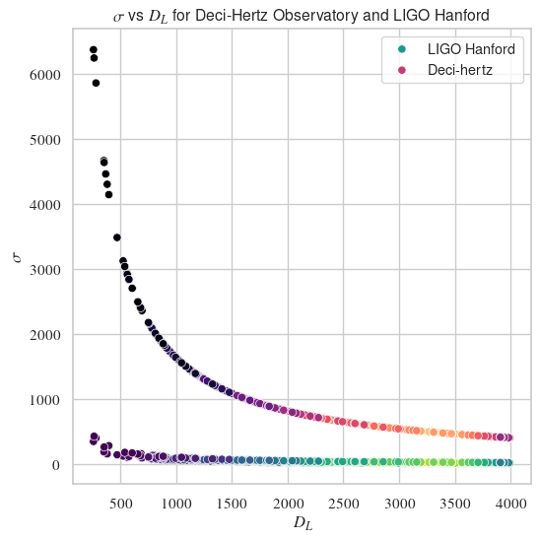
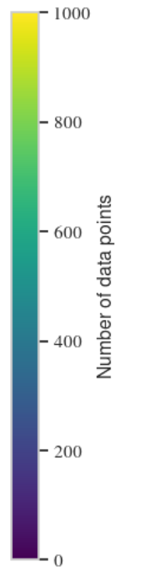
SNR (σ) v/s Luminosity Distance
Fig. 4.2: σ vs luminosity distance for same mass systems for deci-hertz observatory and H1.

Slide 23
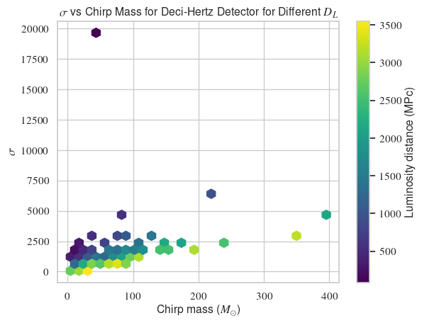
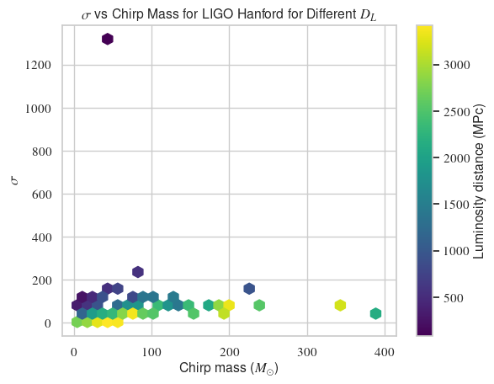
SNR (σ) v/s Chirp Mass
Fig. 4.3: σ vs chirp mass for different distances for deci-hertz observatory (left) and H1 (right).

Slide 24
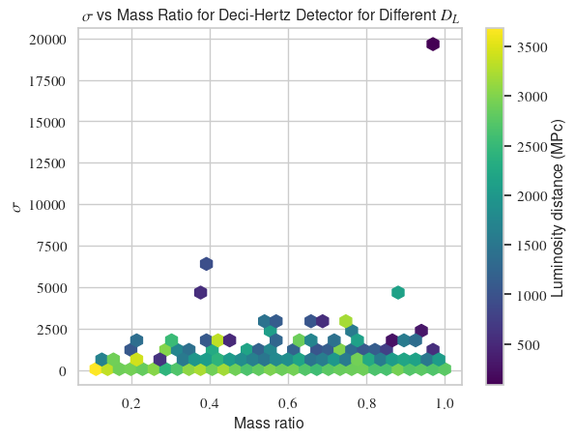
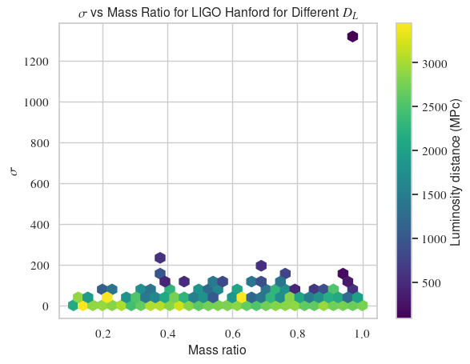
SNR (σ) v/s Mass Ratio
Fig. 4.4: σ vs mass ratio for different distances for deci-hertz observatory (left) and H1 (right).

Slide 25
Conclusions
Proposed deci-hertz observatory has a 100% detection rate
Consistently outperforms the current hecto-hertz detectors
Negative relationship between SNR (σ) and luminosity distance verified
SNR (σ) increases with chirp mass but trend dominated by luminosity distance

Slide 26
Future Directions
Bigger population of BBHs should be used
Conduct signal injections with actual noise and evaluate matched filter SNR
Analysis for IMRIs limited by IMRPhenomD
Data should not be downsampled

Slide 27

Thank you.
Fig.: Rainer Weiss (American physicist)

Slide 28
Follow-up Discussion

Slide 29
More on Source Parameters
Phase: Position of BHs in orbit around each other
Spin vector azimuthal angle: Angle made by spins with direction perpendicular to orbital plane
Precession angle: Angle between total angular momentum and direction of wave propagation, determines the polarization of GWs
Tilt: Angle between the total angular momentum and the LoS from the observer to the binary system

Slide 30
Innermost Stable Circular Orbit (ISCO)
Smallest possible stable orbit that two black holes can have around each other
𝑓_{ISCO} determined by the properties of black holes
More massive black holes have a lower 𝑓_{ISCO}
Why 𝑓_{ISCO} as 𝑓_{high}?
Final frequency as BHs start to merge
More massive BH formed has weak GW signal
Dominated by noise above 𝑓_{ISCO}
(3.2)

Slide 31
Empirical Form of Deci-Hertz PSD
Based on current observations from LIGO noise curve
10⁻²⁴ dominated by flat noise
Downward slope corresponding to 10⁻²⁵
10⁻²³ corresponds to shot and quantum noise
(3.1)

Slide 32
Why this sampling rate?
Sampling rate of a digital signal evaluated by Nyquist sampling theorem
𝑓_{s} > 2𝑓_{max} where 𝑓_{max} is the highest frequency present in the signal
16384Hz captures content upto 8192Hz
Why 16384 and not 16000?
To make it a multiple of the resonant frequencies of the interferometer
Resonant frequency determined by arm length
Resonant frequency ≠ 𝑓_{s} produces beat notes

Slide 33
Threshold at SNR>8
Corresponds to a statistical significance of 5σ (σ=standard deviation)
General accepted value for statistical significance for claiming a discovery
Probability of a false positive detection due to random noise fluctuations extremely low (<1/3.5 million)
Good compromise between sensitivity and computational cost

Slide 34
Why IMRPhenomD?
Most recent model from the IMRPhenom family
Newer than IMRPhenomA/B/C
Takes into account precession of orbits, and finite sizes
Has Post-Newtonian correction terms upto 3.5 orders
What is PN?
Extends Newtonian gravity to include higher order of velocity terms
Includes relativistic effects (time dilation and space-time curvature)
Notes:
Phenomenology: Application of theoretical physics to experimental data by making quantitative predictions based upon known theories. IMRPhenom uses analytical and numerical methods to model waveforms

